Slide 1
SESSION MANAGEMENT
IN ASP.NET
Roll no : 176114

Slide 2
SESSION
What is a session?
  Context in which a user communicates with a server over multiple HTTP requests
  Within the scope of an ASP.NET Application
HTTP is a stateless, sessionless protocol
ASP.NET adds the concept of “session”
  Session identifier: 120 bit ASCII string
  Session variables: store data across multiple requests

Slide 3
SESSION TRACKING
We keep the EnableSessionState property’s default setting—True.
Every Web Form includes an HttpSessionState object, which is accessible through property Session of class Page.
When the web page is requested, an HttpSessionState object is created and assigned to the Page’s Session property.
A distinct HttpSessionState resides on the server, whereas a cookie is stored on the user’s client.
Like a cookie, an HttpSessionState object can store name/value pairs.
The name/value pairs stored in a Session object are often referred to as session items.

Slide 4
SESSION TRACKING
Call Add to place a session item in the HttpSessionState object.
If you add an attribute that has the same name as an attribute previously stored in a session, the object associated with that attribute is replaced.
Another common syntax for placing a session item in
the HttpSessionState object is Session[ name ] = value.

Slide 5
SESSION TRACKING
Property SessionID contains the unique session ID, which identifies each unique client.
Property Timeout specifies the amount of time that an HttpSessionState object can be inactive before it is discarded.
By default, a session times out after twenty minutes.

Slide 6
SESSION IDENTIFIER
By default, session id is stored in a cookie
Can optionally track session id in URL
Requires no code changes to app
  All relative links continue to work
  <configuration>
  <sessionstate cookieless=“true”/>
  </configuration>

Slide 7
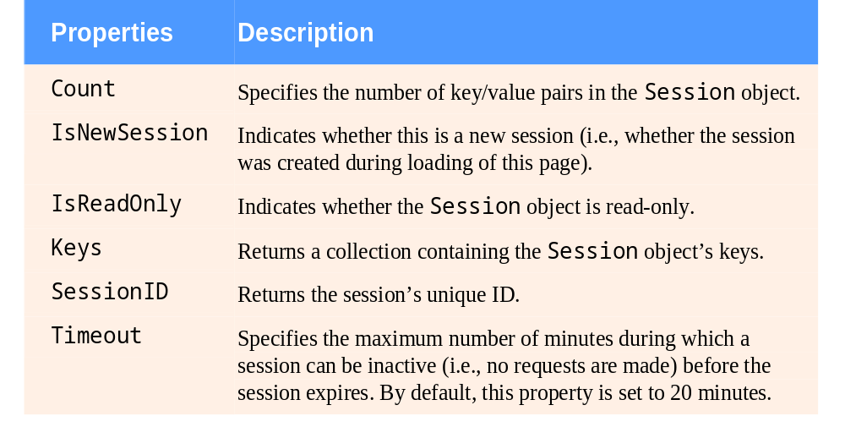
SESSION TRACKING
Some common HttpSessionState properties:

Slide 8
SESSION TRACKING
The Keys property of class HttpSessionState returns a collection containing all the keys in the session.
The value in a key/value pair is retrieved from the Session object by indexing the Session object with the key name.

Slide 9
SESSION VARIABLES
ASP stores session state in IIS process
  State is lost if IIS crashes
  Can’t use session state across machines
ASP.NET stores session state:
  In another process: ASP State NT service
  In SQL Server database
Notes:
KEY MESSAGE: Session variables are enhanced
SLIDE SCRIPT:
Used to store state information for a user. For example, a shopping basket.
Can use cookies, or be cookieless. In the case of cookieless, every URL output by the ASP is modified automatically to contain a session ID.
There’s a service called “ASP State” that listens for requests for state information. By setting up one machine as the “State Server”, and pointing all the other boxes at it, session state can be shared across a web farm.
SLIDE TRANSISTION: Let’s look at this in action.
ADDITIONAL INFORMATION FOR PRESENTER:

